Slide 1

The New QCE System
Unit Reports in TASS
The Mt St Michael’s Approach
Notes:
Mt St Michael’s College Approach to Unit reporting

Slide 2


JOHN HAMILTON
Director of Technology
Mt St Michael’s College
jhamilton@msm.qld.edu.au
Notes:
Questions – Jhamilton@msm.qld.edu.au

Slide 3
Timely,
Accurate,
Informative &
Understandable
Reports for the new QCE
Notes:
Questions – Jhamilton@msm.qld.edu.au

Slide 4

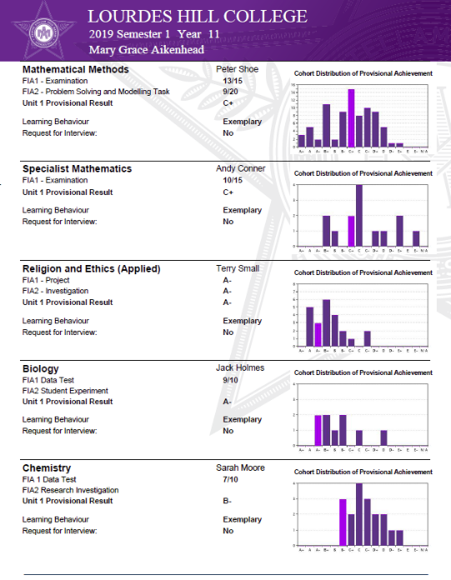
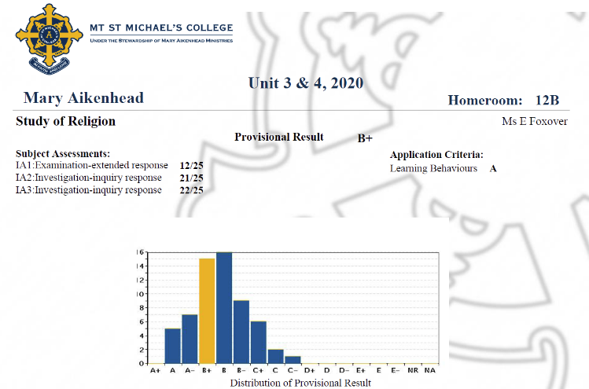
+ Progressive Reporting

Slide 5
Introduction to the new QCE
(Queensland Certificate of Education),
Terminology and school based assumptions
Notes:
Questions – Jhamilton@msm.qld.edu.au

Slide 6

New QCE
Year 12 – from 2020 (Units 3 & 4)
3 x Internal Assessments:
Internal Assessment 1 (IA1)
Internal Assessment 2 (IA2)
Internal Assessment 3 (IA3)
1 x External Assessments (EA)

Slide 7

New QCE
Year 11 – 2019 (Units 1 & 2)
3 x Internal Assessments:
Internal Assessment 1 (FIA1)
Internal Assessment 2 (FIA2)
Internal Assessment 3 (FIA3)
The MSM approach has been to have four(4) formative assessments in Year 11 similar in style, criteria and marking to the Year 12 items
Satisfactory /
Unsatisfactory
1 x Internal Assessment 4 (FIA4)
MSM approach: This item is typically an exam covering
content from Units 1 & 2

Slide 8
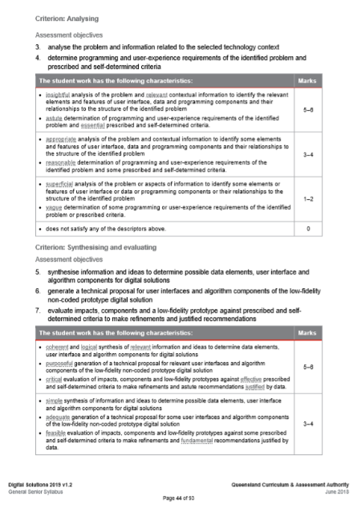
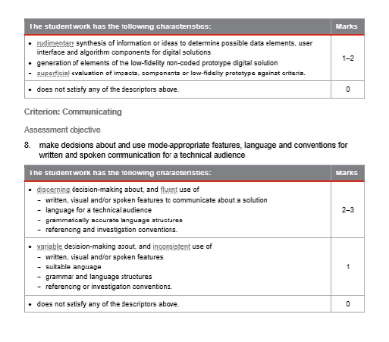
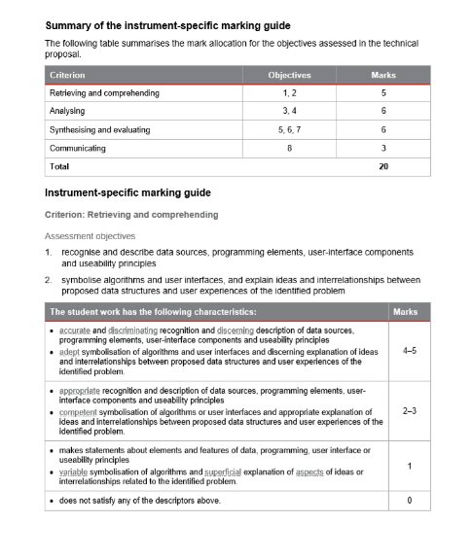
New QCE
Instrument Specific Marking Guides (ISMGs)
Total Numeric Grade
(In this case out of 20)
The MSM approach has been to have adjusted ISMGs for Year 11 with the same criteria as year 12 and numeric grades

Slide 9

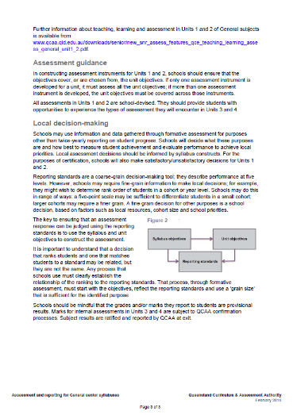
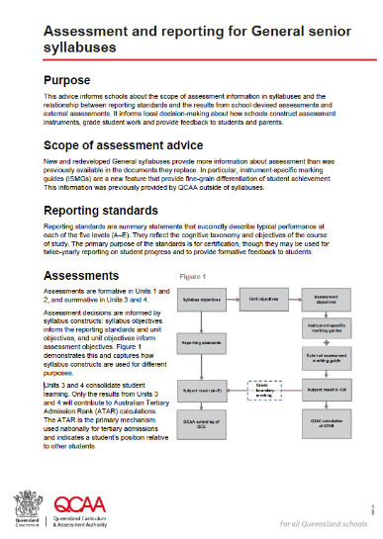
Advice 1
  QCAA
Assessment and reporting for General
Senior Syllabus Units 1 & 2 (Feb 2018)

Slide 10
A+ to E-
Reporting standards are a coarse-grain decision-making tool; they describe performance at five levels. However, schools may require fine-grain information to make local decisions; for example, they might wish to determine rank order of students in a cohort or year level. Schools may do this in range of ways: a five-point scale may be sufficient to differentiate students in a small cohort; larger cohorts may require a finer grain. A fine-grain decision for other purposes is a school decision, based on factors such as local resources, cohort size and school priorities.
The MSM approach has been to report “Provisional Results” for a Unit on an A+ to E- scale
QCAA: Advice 1 – Assessment and reporting for General Senior Syllabus - Units 1 & 2 (Feb 2018)
Notes:
At any one point in time during the day, I can look through our monitoring system and see hundreds of machines all using digital ink.
In this scenario there are some where typing makes sense (like the typing tutor!) or typing up an essay. But a great majority will involve digital ink.

Slide 11
Provisional
Result
Schools should be mindful that the grades and/or marks they report to students are provisional results. Marks for internal assessments in Units 3 and 4 are subject to QCAA confirmation processes. Subject results are ratified and reported by QCAA at exit.
The MSM approach has been to report “Provisional Results” for a Unit on an A+ to E- scale
QCAA: Advice 1 – Assessment and reporting for General Senior Syllabus - Units 1 & 2 (Feb 2018)
Notes:
At any one point in time during the day, I can look through our monitoring system and see hundreds of machines all using digital ink.
In this scenario there are some where typing makes sense (like the typing tutor!) or typing up an essay. But a great majority will involve digital ink.

Slide 12
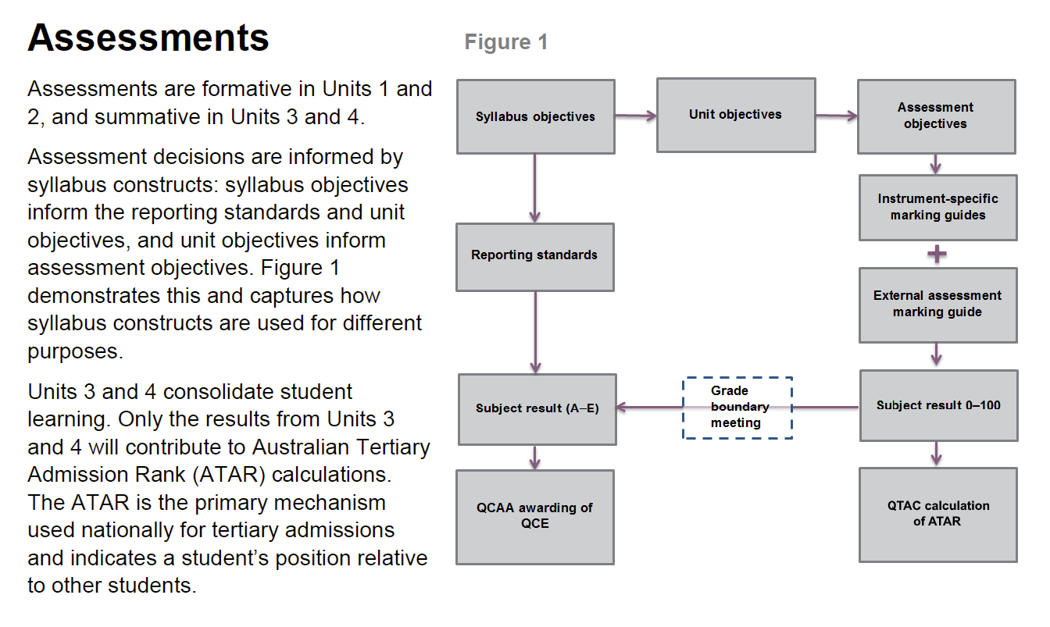
ADVICE 1
Grade Boundary Meetings
Advice 1 – Assessment
and reporting for General
Senior Syllabus
Units 1 & 2 (Feb 2018)
A to E scale
Numeric

Slide 13
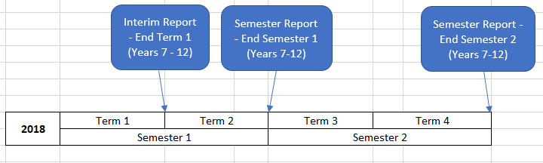
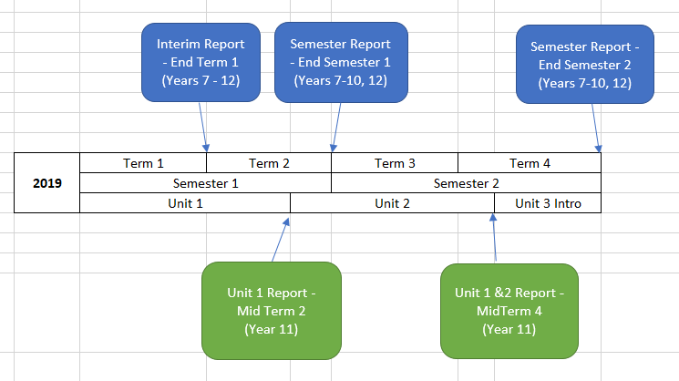
REPORTING
PERIODS
Traditionally at Mt St Michael’s College we have operated three (3) reporting periods.
In 2019, we have the standard three reporting periods PLUS
two additional reporting periods for the Unit 1 and Unit 2 reports
This is driven primarily because we intend to report at different times
Notes:
Interactive Desks where you can write on your desk. It will be like a computer thing.
Not having to carry your textbook because the “Disks” are on your computer. (BTW … the disks are gone and we use the cloud now).

Slide 14
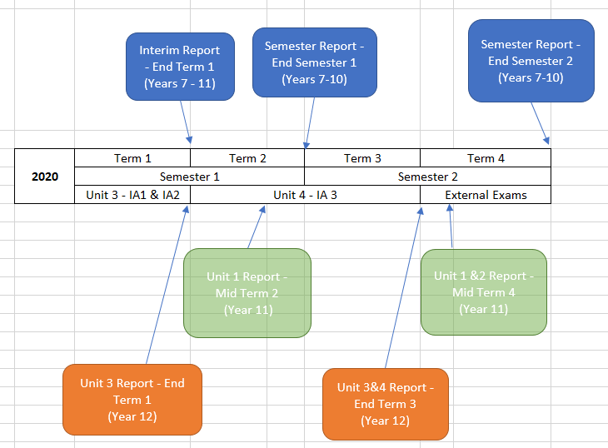
REPORTING
PERIODS
Traditionally at Mt St Michael’s College we have operated three (3) reporting periods.
12?
In 2020, we have the standard three reporting periods PLUS four (4) additional reporting periods for the Unit 1 & 2 and Unit 3 & 4 reports.
This is driven primarily because we intend to report at different times and different reporting period names
Notes:
Interactive Desks where you can write on your desk. It will be like a computer thing.
Not having to carry your textbook because the “Disks” are on your computer. (BTW … the disks are gone and we use the cloud now).

Slide 15
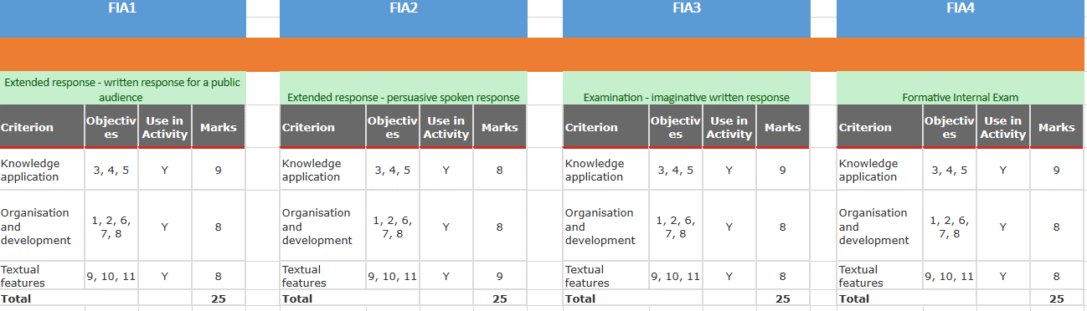
Objectives
Year 11/12 Objectives for FIA1-4 and IA1-3/EA
SUBJECT: ENGLISH (0001)
The MSM approach has been to record the individual marks from each of the criterions from the ISMG in TASS for progressive reporting

Slide 16
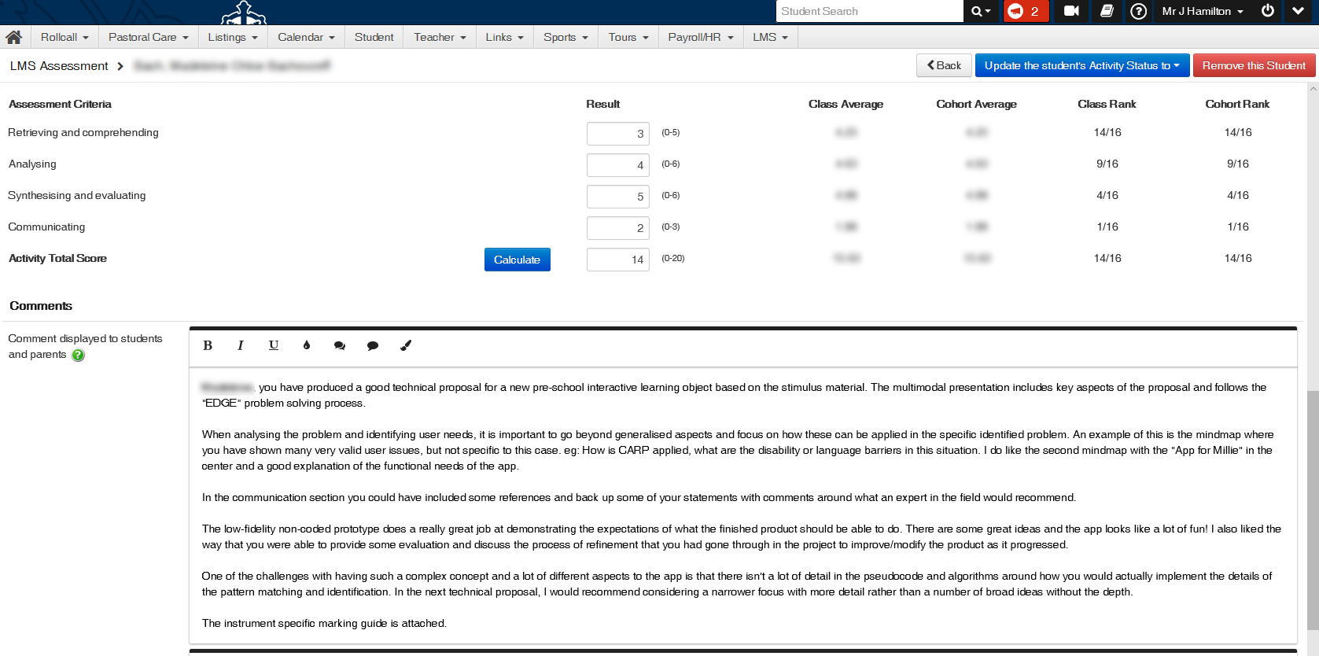
Objectives
Progressive Reporting

Slide 17
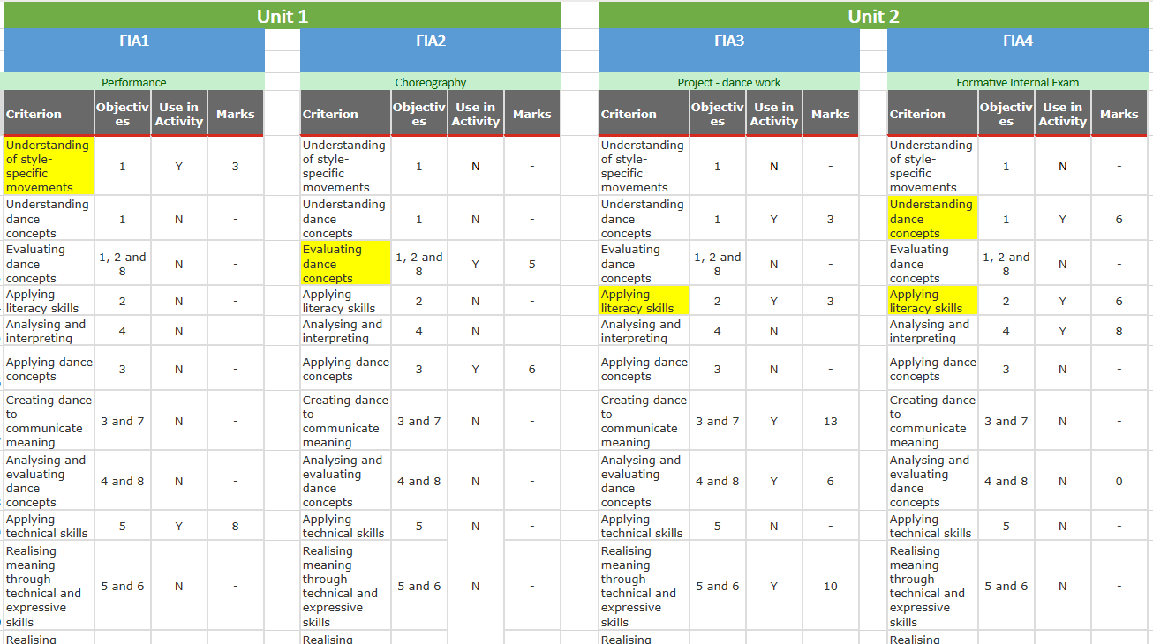
Objectives
Year 11/12 Objectives for FIA1-4 and IA1-3/EA
SUBJECT: DANCE (0085)
13 Unique criterion exist for drama

Slide 18
Initial TASSWeb and teacher kiosk setup
Notes:
Questions – Jhamilton@msm.qld.edu.au

Slide 19
SETUP AND CONFIGURATION
1
2
3
4
5
Assessment Method Definition
Create Objectives
Result Format
Result Period Definition
Activity Creation
TASSWeb
Teacher Kiosk

Slide 20
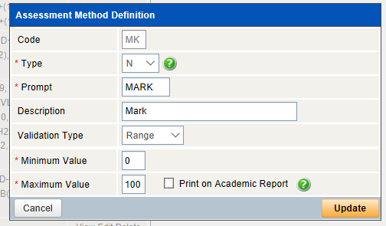
Step 1
Create a Mark style Assessment Method with a 0-100 range. We have called this “MARK”:
(We only do this once. All subject objectives use this Assessment method)
Assessment Method Definition
Note: If you are reporting on criteria AND assessment tasks, this step is more complex and each variation of the total needs to be created.

Slide 21
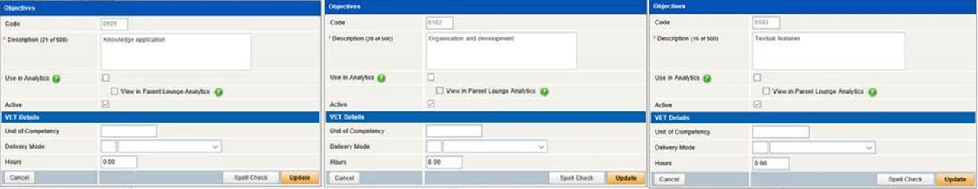
Step 2
Use the objectives from the ISMGs for each subject
CREATE OBJECTIVES

Slide 22
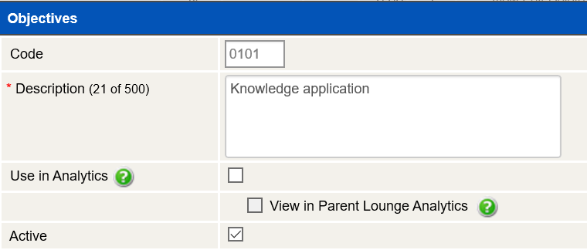
The MSM approach has been to create the code using:
2 Digit subject number +
2 Digit objective count
Step 2
Use the objectives from the ISMGs for each subject
CREATE OBJECTIVES

Slide 23
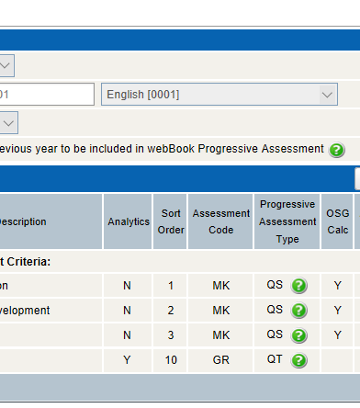
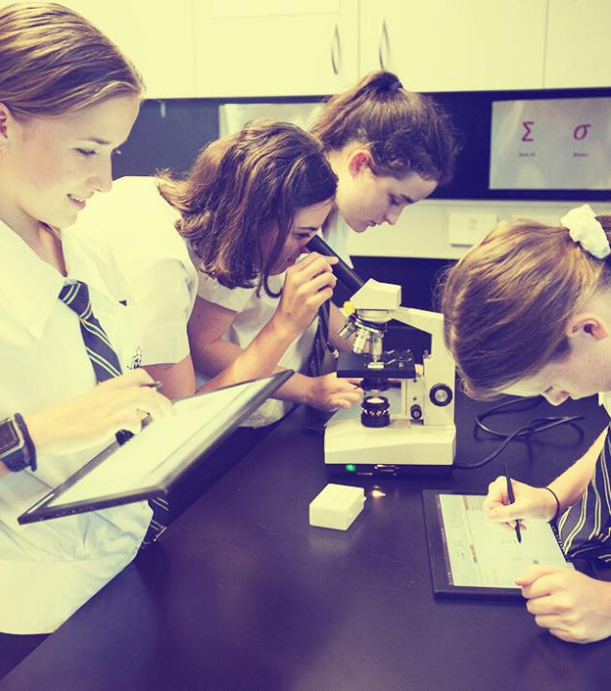
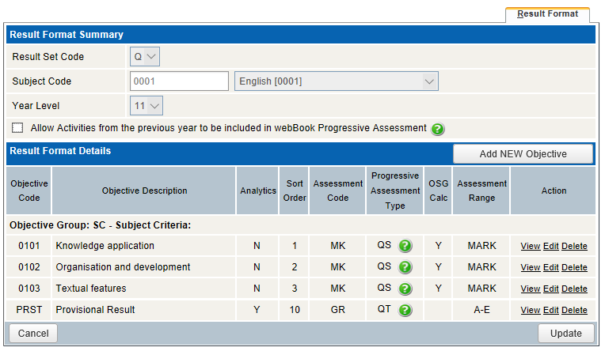
Step 3
Add the objectives to the result format for the subject
RESULT FORMAT

Slide 24
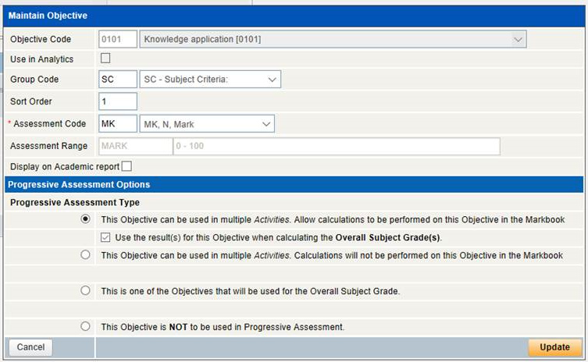
Step 3
Add the objectives to the result format for the subject
The MSM approach has been to not display the criteria on the report. This simplifies the report, the configuration steps and the calculations at the end
RESULT FORMAT

Slide 25
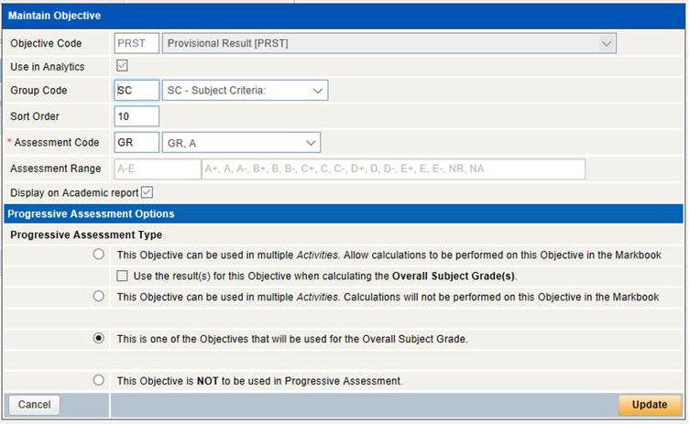
Step 3
Add the objectives to the result format for the subject
The Provisional Result is the only objective we do display on the reports
RESULT FORMAT

Slide 26
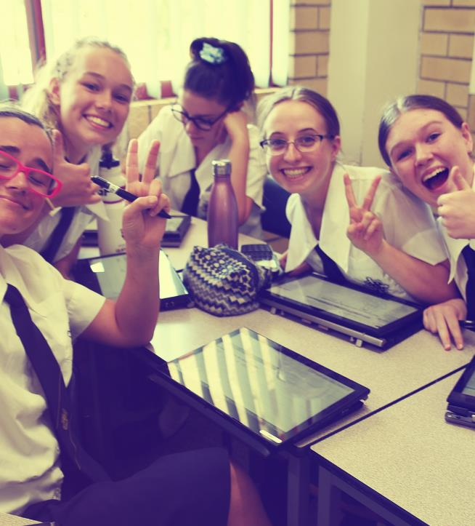
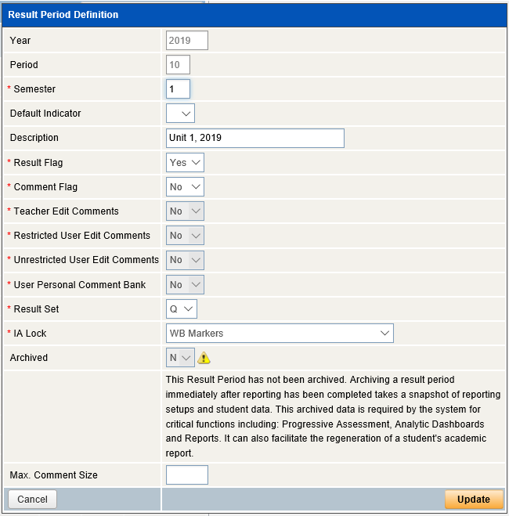
Step 4
RESULT PERIOD DEFINITION

Slide 27
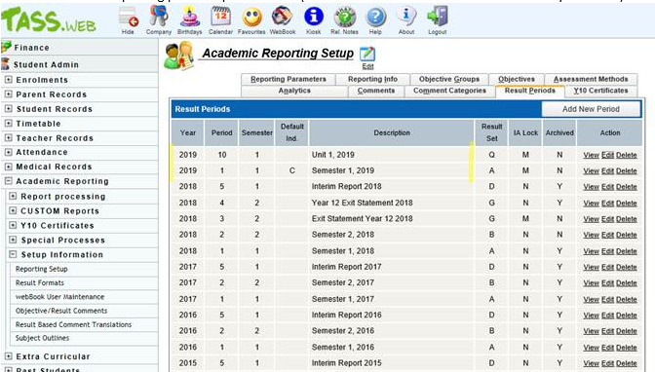
Step 4
RESULT PERIOD DEFINITION

Slide 28
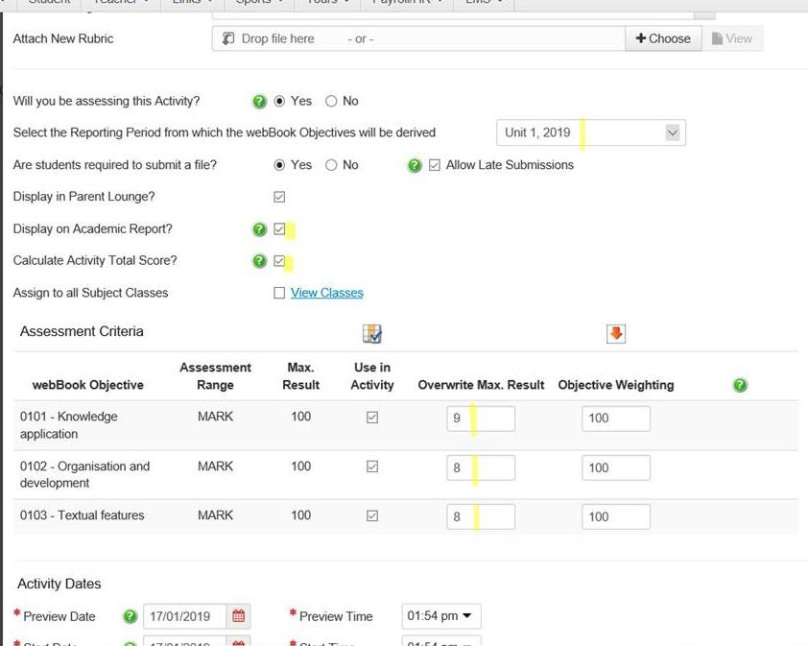
Step 5
ACTIVITY CREATION

Slide 29
Teacher result entry and total calculation
Notes:
Questions – Jhamilton@msm.qld.edu.au

Slide 30
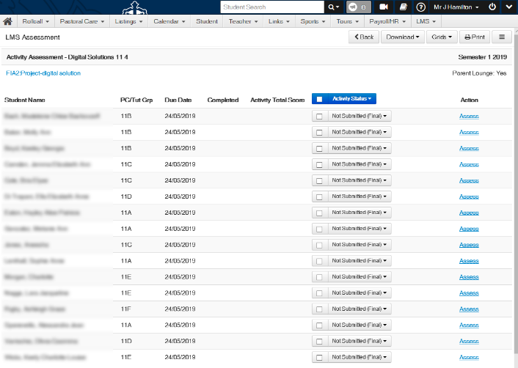
READY TO MARK
Teachers mark the activities
Assess
TK _ LMS->LMS Assessment _ Select Activity

Slide 31
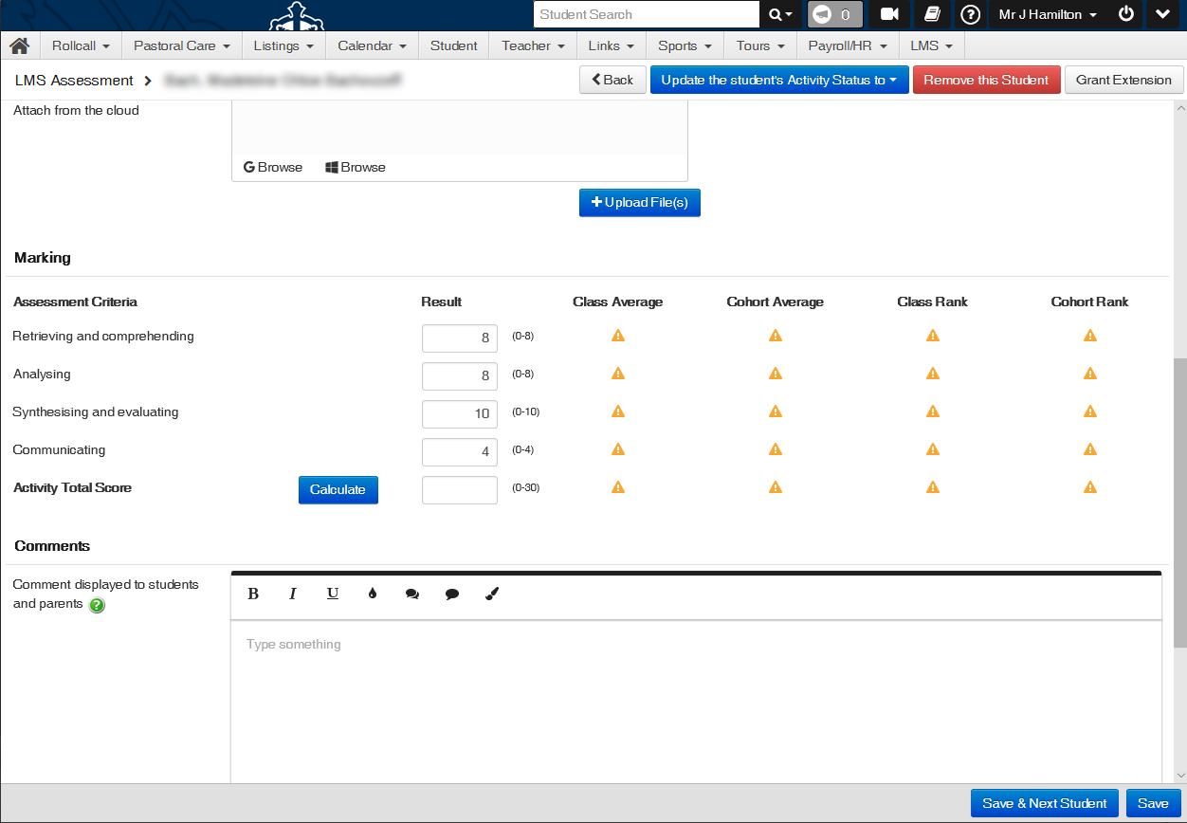
READY TO ENTER MARKS

Slide 32
READY CALCULATE

Slide 33
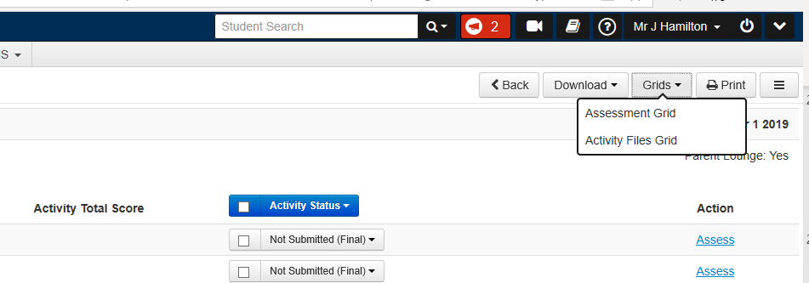
Alternative
Enter results via the Assessment Grid

Slide 34
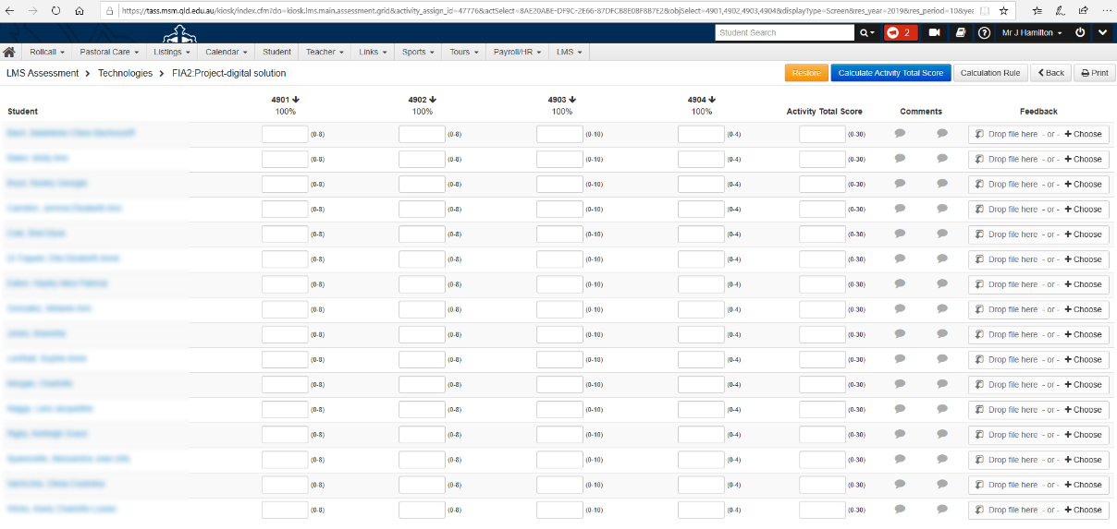
Alternative
Enter results via the Assessment Grid
Notes:
How did we get from where we were 6 years ago to where we are now.
5+ years ago , we had the machines and equipment in place
But digital ink was only used in specialist areas.
So we started to pilot a couple of teachers.

Slide 35
CALC RULES | A calculation rule needs to be applied for the calculate button to work
ISSUES
Notes:
Lets discuss some issues with implementation

Slide 36
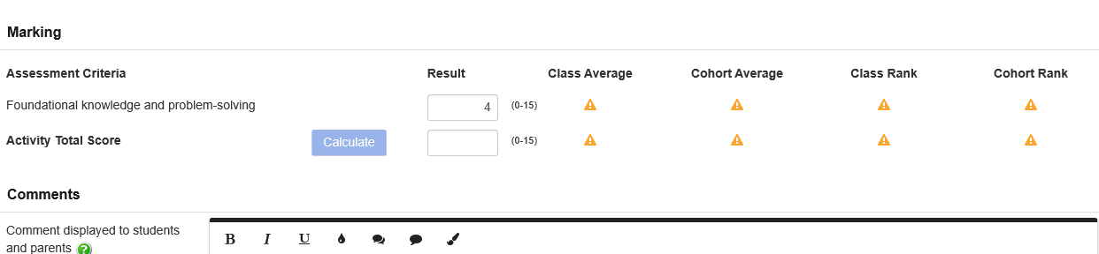
ISSUE
What the user experiences …
Calculate button is “light” and can’t be pressed.
Notes:
How did we get from where we were 6 years ago to where we are now.
5+ years ago , we had the machines and equipment in place
But digital ink was only used in specialist areas.
So we started to pilot a couple of teachers.

Slide 37
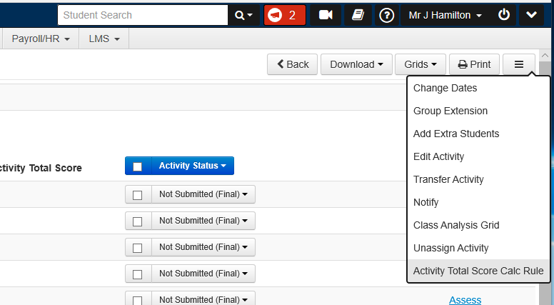
ISSUE Solution
Select the “Activity Total Score Calc Rule”
Notes:
How did we get from where we were 6 years ago to where we are now.
5+ years ago , we had the machines and equipment in place
But digital ink was only used in specialist areas.
So we started to pilot a couple of teachers.

Slide 38
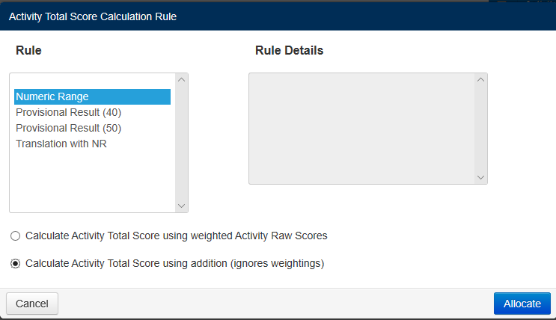
ISSUE Solution
Select the “Activity Total Score Calc Rule”
Note: This needs to be repeated for every assessment item for every subject (every class?)
Approx. 30x4 times for us

Slide 39
WEBBOOK | No calculate buttons in webbook
ISSUES
Notes:
Lets discuss some issues with implementation

Slide 40
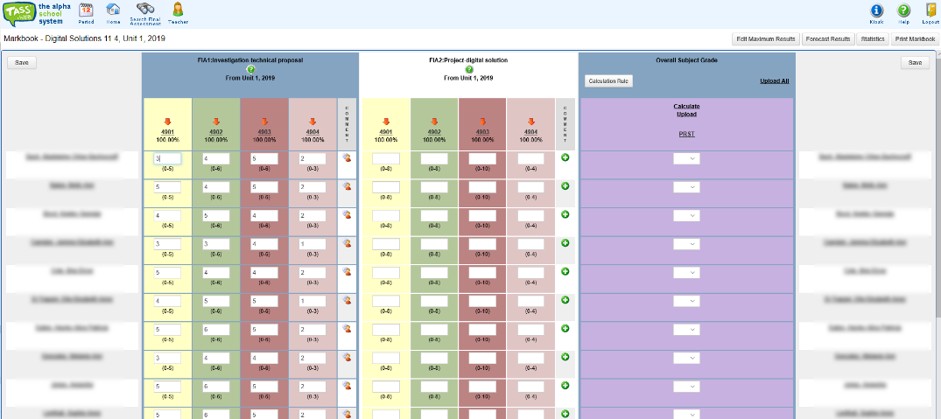
ISSUE
No calculate totals button in webbook for activity total scores

Slide 41
ISSUE
Solution
No calculate totals button in webbook for activity total scores
We removed the webbook license from teachers so that they have to use LMS-LMS Assessment during the Unit
And then reenable the license for access to calculate the Provisional result at the end of the period.

Slide 42
CALCULATE | Using the button is need to calculate the TOTAL (out of value) as well as the actual sum of values
ISSUES
[Don’t add up totals by hand]
Notes:
Lets discuss some issues with implementation

Slide 43
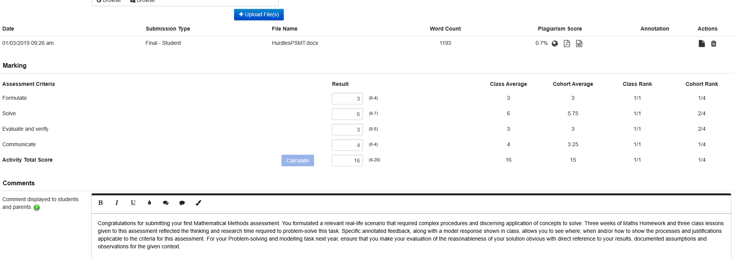
ISSUE
Total added up by hand

Slide 44
ISSUE
Solution
Total added up by hand
Ensure calculation rules are enabled so that the “Calculate” button works and the temptation to add up by hand is removed.
Train staff to always use the “Calculate” button

Slide 45
End of Unit processing and Webbook calculation
Notes:
Questions – Jhamilton@msm.qld.edu.au

Slide 46
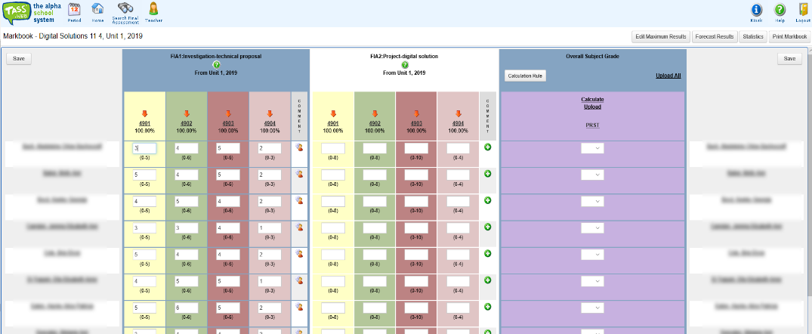
At the end of the unit teachers use the “Calculate” to calculate the provisional result
Provisional
Results

Slide 47
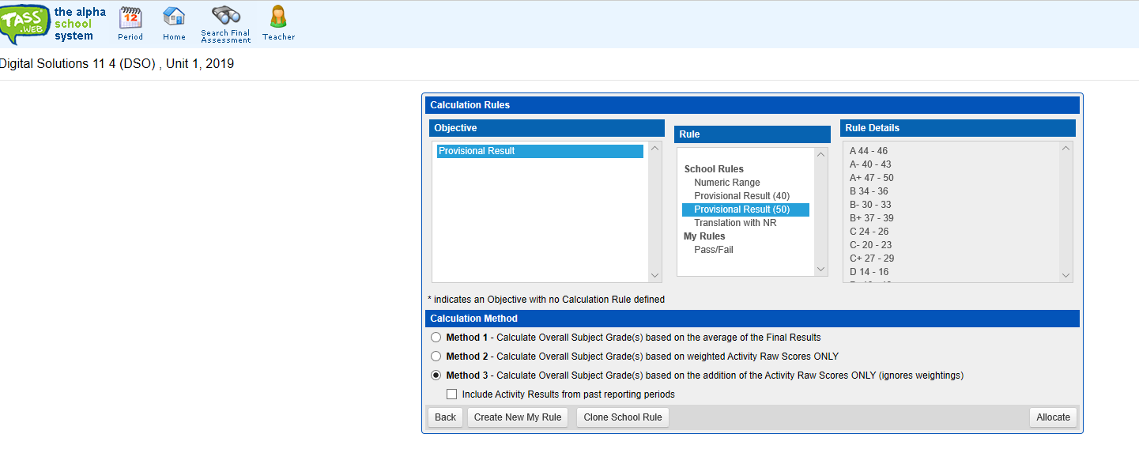
Calc
Rule
Select the correct calculation rule based on the total
of the assessment tasks to date
Use Method 3

Slide 48
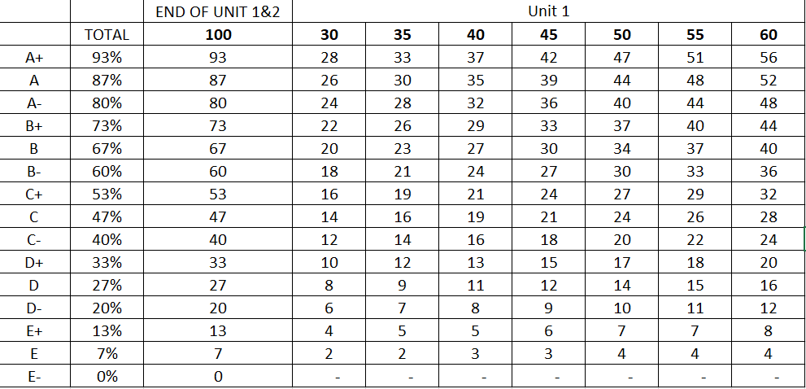
Calc
Rule
Cut offs and unit totals
Our approach for 2019 and 2020 has been to have standard cutoffs across all subjects
but different totals depending on the weighting of FAI1+FAI2

Slide 49
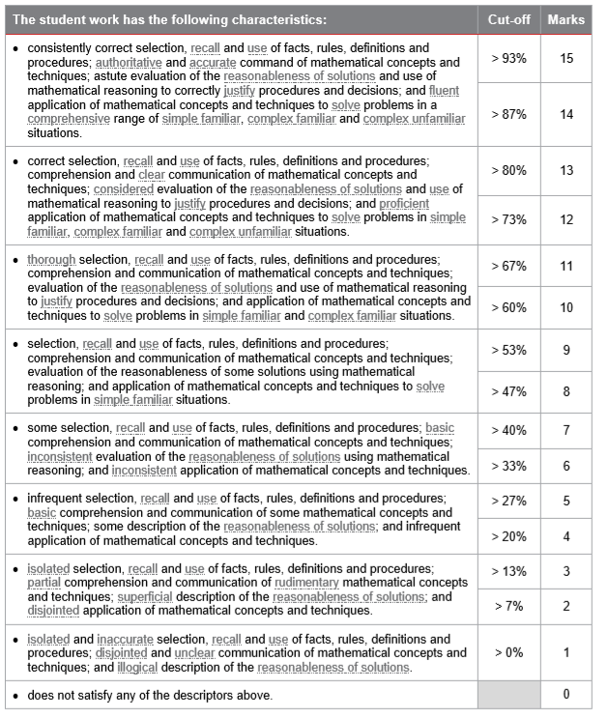
Calc
Rule

Slide 50
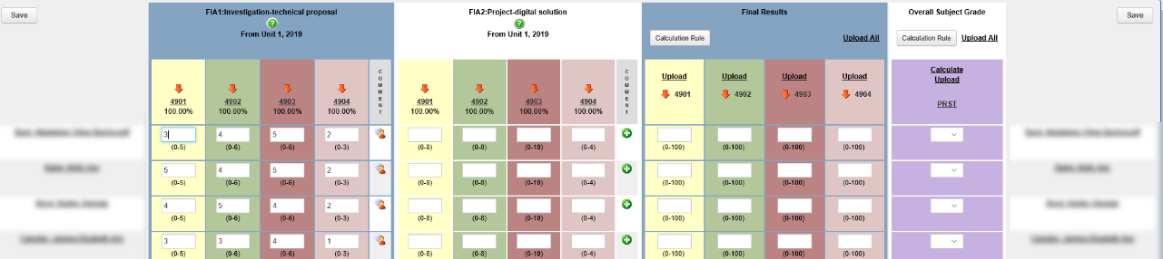
ISSUE
“Final Results” are almost meaningless

Slide 51
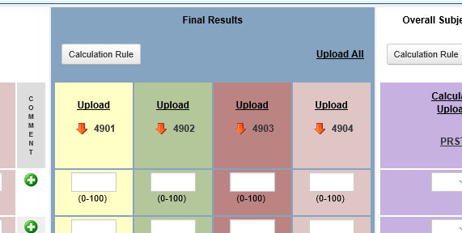
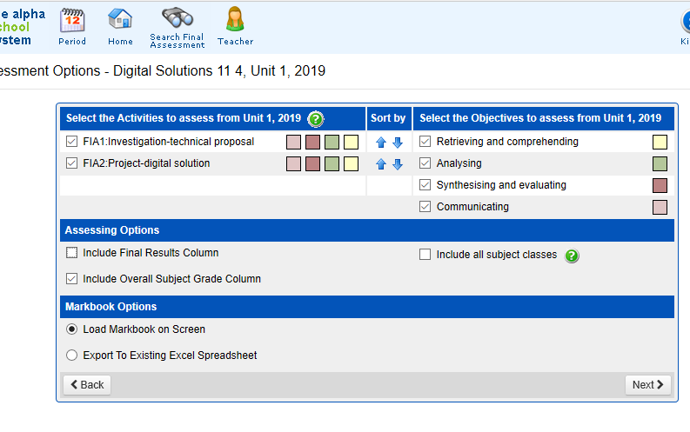
ISSUE
Solution
“Final Results” are almost meaningless
Don’t apply a calculation rule
And don’t calculate these columns
Untick the “Include Final Results Column”
so it doesn’t show

Slide 52
Generate Student Reports
Notes:
Questions – Jhamilton@msm.qld.edu.au

Slide 53
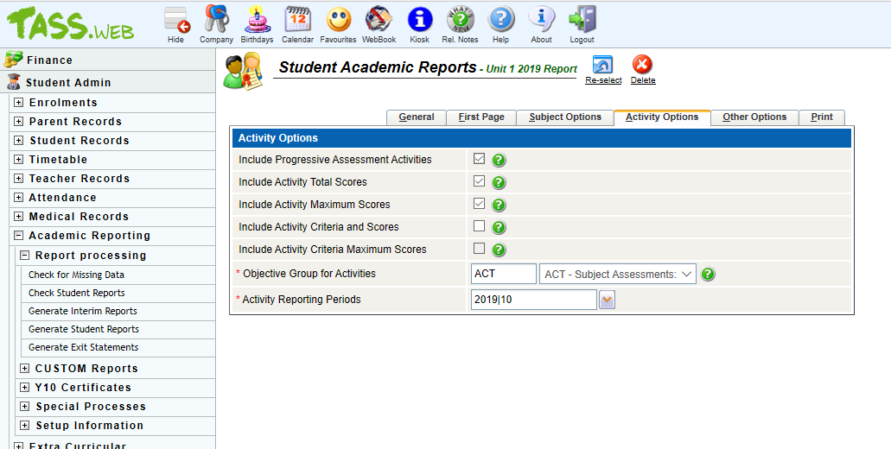
Select appropriate Activity Options
when you Generate Student Reports
Generate Student
Reports

Slide 54
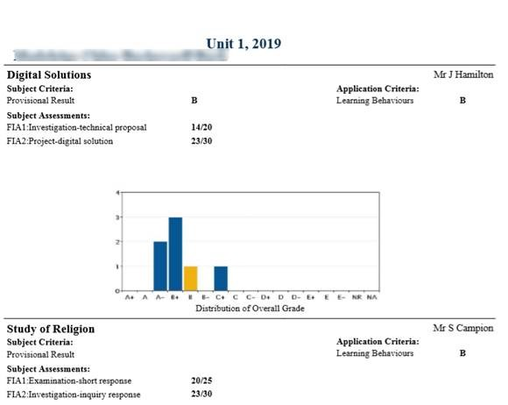
Report

Slide 55
More complications …
Notes:
Questions – Jhamilton@msm.qld.edu.au

Slide 56
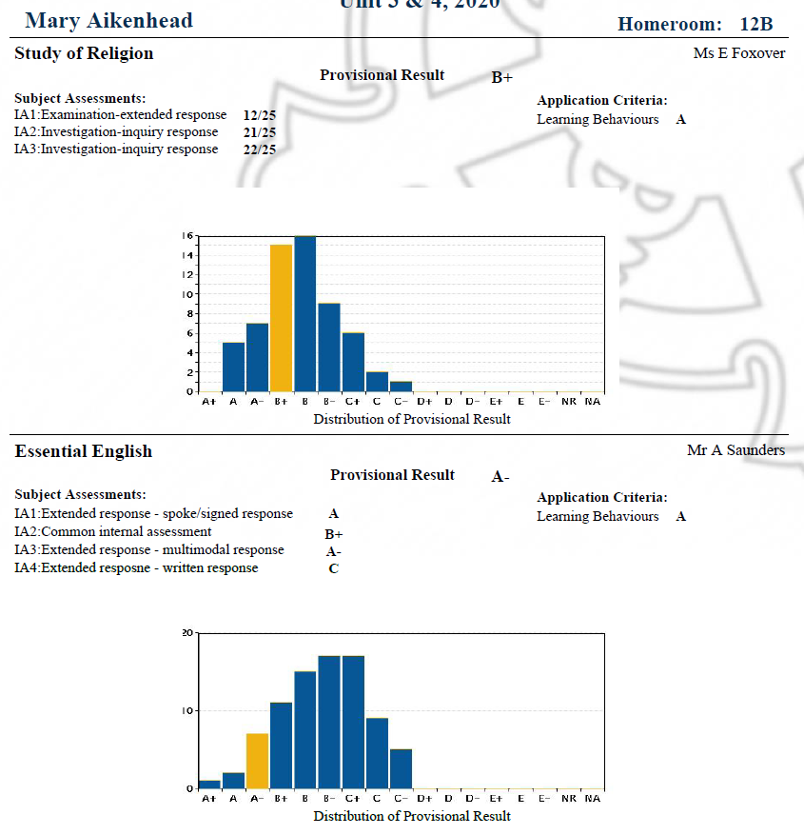
Applied
Subjects

Slide 57
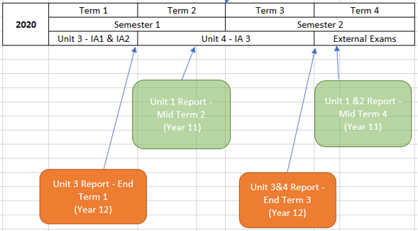
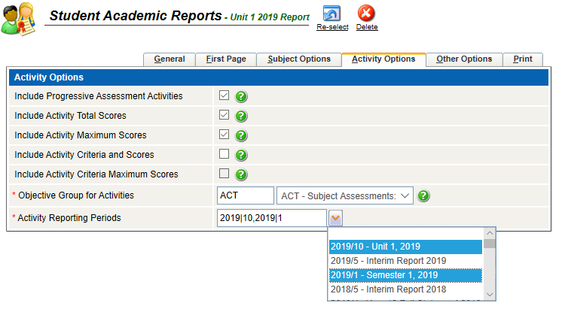
Activities across two periods
The Unit 1&2 and 3&4 reports have activities across two (2) reporting periods.
Use the multi-select to include more than one reporting period

Slide 58
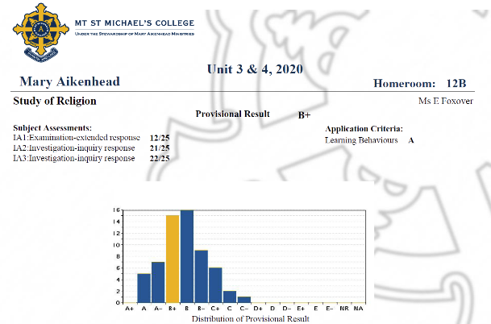
STYLING

Slide 59
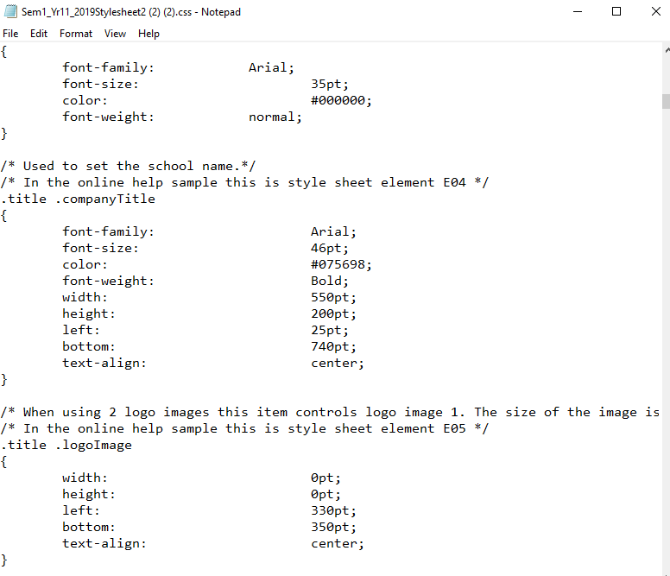
STYLING
Custom CSS

Slide 60
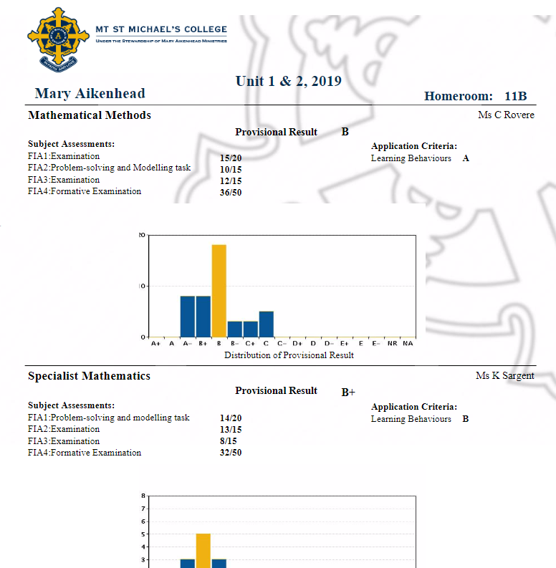
Comments
Notice no comments!

Slide 61

Comments
Detailed timely, instrument specific comments through progressive reporting

Slide 62
QUESTIONS?
jhamilton@msm.qld.edu.au
Notes:
Questions – Jhamilton@msm.qld.edu.au

Slide 63

QCAA – From syllabus to subject result
https://www.youtube.com/watch?v=MiV2HSVUJXA
3:55 mins
Notes:
https://www.youtube.com/watch?v=MiV2HSVUJXA
3:55mins run time

Slide 64


Slide 65
ADVICE 1
Grade Boundary Meetings
Advice 1 – Assessment
and reporting for General
Senior Syllabus
Units 1 & 2 (Feb 2018)
A to E scale
Numeric

Slide 66
QUESTIONS?
jhamilton@msm.qld.edu.au
Notes:
Questions – Jhamilton@msm.qld.edu.au

